Slide 1
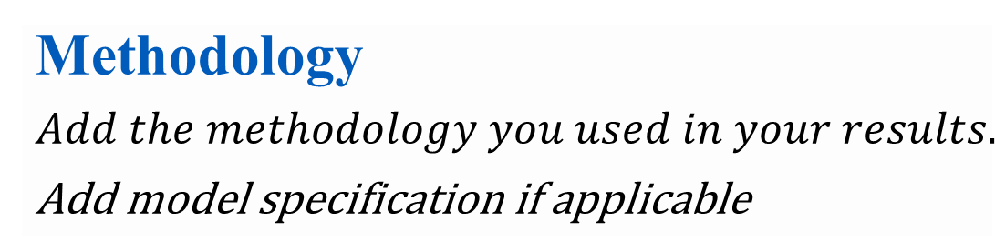

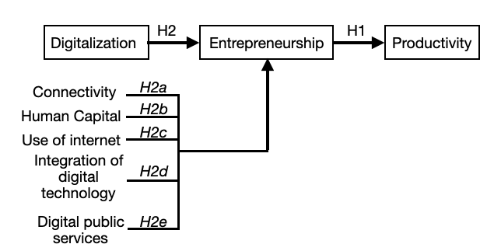



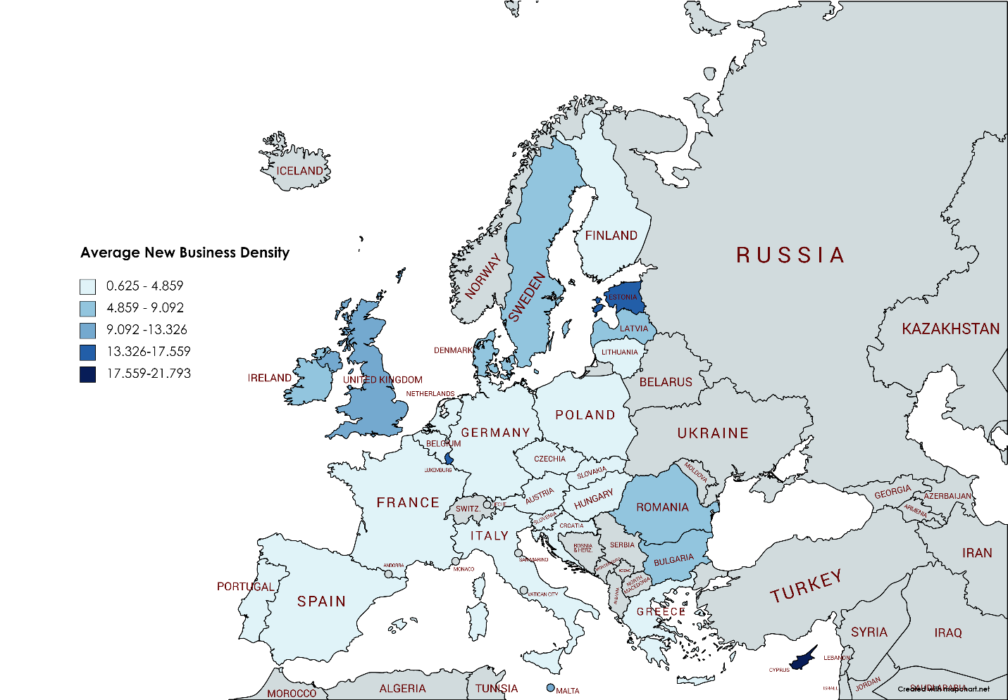


Thesis Title
Student Name (Faculty: Major) and Supervisor Name (Title): The German university in Cairo
Student email. Supervisor email
Introduction
Add up to 100 word that explains the objective of the thesis.
Conclusion
Display the importance of your thesis and contribution to literature
Literature Review
Add the most influential literature review for this topic.
Results
GDP per labor employed (PPP) as a dependent variable | (a) | (b) | (c)
Number of New limited liability companies registered | 0.0184303*** (0.0062208) | 0.0164434** (0.007921) | 0.014161* (0.0077576)
General government consumption expenditure | -0.1508403*** (0.0499205) | -0.1371214*** (0.0450752) | -0.1668492*** (0.050164)
Gross capital formation | 0.0041074 (0.0170303)
Lag GDP per labor employed (PPP) | 0.8206173*** (0.0321649) | 0.7547399*** (0.0338441) | 0.7462118*** (0.0531708)
Life expectancy at birth |  |  | 0.4913513** (0.209014)
Tax revenue |  | -0.173397 (0.021234)
Exports |  | 0.0557905*** (0.168834)
Constant | 0.9953226*** (0.2272107) | 1.241103*** (0.2044953) | 0.4736435** (0.2046414)
Model | Fixed | Fixed | Fixed
R-squared (overall) | 0.9866 | 0.9829 | 0.9845
F [prob>F] | F(4,27)= 433.41 [0.0000] | F(5,27)= 331.67 [0.0000] | F(4,27)= 208.44 [0.0000]
Number of obs. | 353 | 353 | 353
References
Abu-Shanab, E. A., & Osmani, M. (2019). E-Government as a Tool for Improving Entrepreneurship. International Journal of Electronic Government Research (IJEGR), 15(1), 36-46.
Alderete, M. V. (2017). Mobile broadband: A key enabling technology for entrepreneurship?. Journal of Small Business Management, 55(2), 254-269.
Aparicio, S., Urbano, D., & Audretsch, D. (2016). Institutional factors, opportunity entrepreneurship and economic growth: Panel data evidence. Technological forecasting and social change, 102, 45-61
Audretsch, D. B., & Keilbach, M. (2005). Entrepreneurship capital and regional growth. The Annals of Regional Science, 39(3), 457-469.
Carlsen, L. & Zhou, K. (2012). Broadband and Entrepreneurship: A cross-country study of 23 OECD countries between 2004 and 2009. [Bachelor’s thesis- Stockholm school of Economics].
Carlsson, B., Braunerhjelm, P., McKelvey, M., Olofsson, C., Persson, L., & Ylinenpää, H. (2013). The evolving domain of entrepreneurship research. Small Business Economics, 41(4), 913-930.
Carree, M., van Stel, A., Thurik, R. & Wennekers, S. (2002). Economic Development and Business Ownership: An Analysis Using Data of 23 OECD Countries in the Period 1976-1996. Small Business Economics, 19(3):271-90.
Digital Economy and Society Index (DESI) 2020 Methodological note. Retrieved 6 Dec. 2020 from the European Commission: https://ec.europa.eu/digital-single-market/en/digital-economy-and-society-index-desi
Doing Business (2020). Entrepreneurship. Retrieved Oct. 3rd, 2020 from The World Bank Website: https://www.doingbusiness.org/en/data/exploretopics/entrepreneurship/methodology
Fossen, F. M., & Sorgner, A. (2019). Digitalization of work and entry into entrepreneurship. Journal of Business Research.
GEM (2020). Definitions. Retrieved Oct. 3rd, 2020 from Global Entrepreneurship Monitor: https://www.gemconsortium.org/wiki/1154
Holtz-Eakin, D., & Kao, C. (2003). Entrepreneurship and economic growth: the proof is in the productivity. Syracuse University Center for Policy Research Working Paper, (50).
Ivanović-Đukić, M., Stevanović, T., & Rađenović, T. (2019). Does digitalization affect the contribution of entrepreneurship to economic growth?. Zbornik radova Ekonomskog fakulteta u Rijeci: časopis za ekonomsku teoriju i praksu, 37(2), 653-679.
Kelley, D. & Wright, F. (2020). COVID-19 Impacts on Entrepreneurship: United States. In A. Ionescu-Somers & A. Tarnawa (Ed.) Diagnosing COVID-19 Impacts on Entrepreneurship: Exploring policy remedies for recovery. (pp. 26-32). London: Global Entrepreneurship Research Association (GERA). https://www.gemconsortium.org/reports/covid-impact-report
Kende, M. (2015). ICTs for Inclusive growth. E-Entrepreneurship on the open internet. In S. Dutta, T. Geiger & B. Lanvin (Ed.). The Global Information Technology Report 2015 (pp. 49-55). Geneva: World Economic Forum. https://www.weforum.org/reports/global-information-technology-report-2015
Levine, R., & Rubinstein, Y. (2017). Smart and illicit: who becomes an entrepreneur and do they earn more?. The Quarterly Journal of Economics, 132(2), 963-1018.
Nambisan, S. (2017). Digital entrepreneurship: Toward a digital technology perspective of entrepreneurship. Entrepreneurship Theory and Practice, 41(6), 1029-1055.
Salgado-Banda, H. (2007). Entrepreneurship and economic growth: An empirical analysis. Journal of Developmental Entrepreneurship, 12(01), 3-29
Wennekers, S., & Thurik, R. (1999). Linking entrepreneurship and economic growth. Small business economics, 13(1), 27-56.
World Bank (2020). The World Bank Data. Retrieved Oct. 3rd, 2020 from The World Bank Website: https://data.worldbank.org/indicator/SL.EMP.SELF.ZS
World Economic Forum (2019). Beyond borders: Digitizing Entrepreneurship for impact. Community Paper. Retrieved 10 Dec. 2020 from the World Economic Forum: http://www3.weforum.org/docs/WEF_Digitizing_Entrepreneurship_for_Impact_Report.pdf
Add the most important refernces
Try to visualize your idea and data
Display your Results
Ent. as a dep. variable |  | (d) | (e) | (f) | (g) | (h) | (i)
Independent variables
DESI | 0.583*** (0.154)
Connectivity |  |  | 0.583*** (0.154)
Human Capital |  |  |  | -0.679 (0.685)
Use of internet |  |  |  |  | 0.740*** (0.214)
Integration of Digital technology |  |  |  |  |  | 0.222 (0.148)
Digital public services |  |  |  |  |  |  | 0.513*** (0.181)
Control Variables
Population | 0.683*** (0.162) |  | 0.683*** (0.162) | 2.088*** (0.844) | 0.723*** (0.164) | 0.746*** (0.173) | 0.743*** (0.143)
Tax revenue | -0.402 (0.403) |  | -0.402 (0. 403) | -0.641 (0.500) | -0.334 (0.349) | -0.348 (0.484) | -0.557 (0.361)
Exports | 0.052 (0.511) |  | 0.052 (0.511) | 0.815 (0.654) | 0.126 (0.533) | 0.252 (0.562) | 0.227 (0.422)
GDP per capita (PPP) | -0.201 (0.390) |  | -0.201 (0.390) | 1.327** (0.504) | -0.014 (0.421) | 0.382 (0.362) | -0.040 (0.440)
Constant | -1.015 (1.796) |  | 0.503 (1.741) | -15.999*** (5.498) | 0.923 (1.843) | -2.662 (2.292) | -0.670 (1.559)
Model | Random |  | Random | Fixed | Random | Random | Random
R-squared (overall) | 0.6230 |  | 0.6230 | 0.5901 | 0.6272 | 0.5921 | 0.6053
Wald Chi2(5) Prob>Chi2 | 69.51 [0.0000] |  | 69.51 [0.0000] |  | 87.59 [0.0000] | 64.31 [0.0000] | 61.84 [0.0000]
F [prob>F] |  |  |  | F(5,27)=8.08 [0.0000]
Num. of obs. | 112 |  | 112 | 112 | 112 | 112 | 112
Conceptual Framework
Average New business density 2006-2018
Source: Data from doing business data, world bank (2020)
Prepared for Thesis Poster Display Conference
11th -12th June 2022

